Slide 1
Recreational Visits to National Park Statistical Analysis
Christopher Flowers, M.s. of Data Analytics

Slide 2
The Problem
People visits are National Parks each year for various reasons. Among those National Parks are the Great Smokey Mountain and Yellowstone National Parks. But who has the most visitors.

Slide 3
The Reality
The National Parks Service has hundreds of National Parks across this nation. It would be hard for them to keep a close eye on number of visits to each park. We need to know how many visitors for each park and what kind of visitors. This will allow for financial means be directed to where they can be used.

Slide 4
The Hypothesis
Monthly Recreational Visits to the Great Smokey Mountains National Park occur no statistically significant difference from monthly Recreational Visits to Yellowstone National Park.

Slide 5
The Alternative Hypothesis
Monthly Recreational Visits to the Great Smokey Mountains National Park occur at a statistically significant higher rate than monthly Recreational Visits to Yellowstone National Park.

Slide 6
The Data Used
22,896 Records of All National Parks, Stats Report Viewer
297,115,406 recreation visits, Visitation Numbers (U.S. National Park Service)
18 Total Columns
5 years of data
9 different types of visitors

Slide 7
The Preparation
14 columns removed
1 column added(aggregate column)
0 data type conversions
0 data removed for duplication

Slide 8
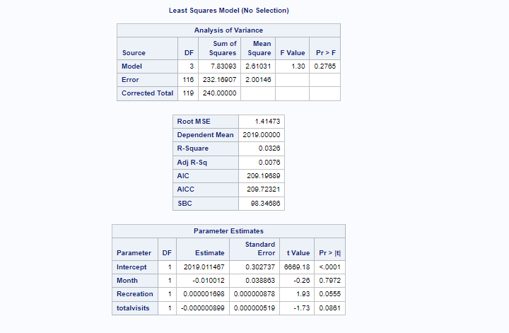
The Data Analysis
Check the correlation of the variables.

Slide 9
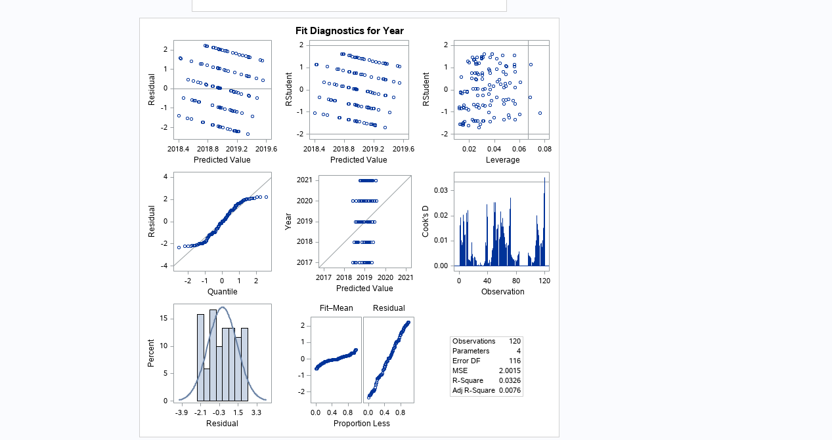
The Findings
P-Value is <.0001 for the intercept.
Estimate of intercept is 2019.011467.

Slide 10
Limitations
Only has five years of data
Dataset when filtered is small at 120 records.
Skewed values for pandemic years.
Only compared two parks

Slide 11
Actions Proposed and Benefits
Helps determine which parks are visited more than others.
Allows for direction of finances to more visited National Parks.
Helps in the creation of new areas(camp sights, hiking trails, etc.) at National Parks.
Shows how COVID has changed visits to National Parks.

Slide 12
Sources
Stats Report Viewer. (2022). Retrieved 16 May 2022, from https://irma.nps.gov/STATS/SSRSReports/National%20Reports/Query%20Builder%20for%20Public%20Use%20Statistics%20(1979%20-%20Last%20Calendar%20Year)
Visitation Numbers (U.S. National Park Service). (2022). Retrieved 12 May 2022, from https://www.nps.gov/aboutus/visitation-numbers.htm

